Slide 1


Voice communication system for a spacesuit simulator
Design and performance estimation of the system with additional analysis of the usability on Mars
Omar Filip El Sendiouny

Slide 2
Overview
Introduction
About the thesis
Aim & deliverables
Voice communication system for a spacesuit simulator
System design & Methodolgy
Results & martian application
Self-sufficient energy distribution system
System design & Methodolgy
Results & martian application
Conslusion & critical reflection
Voice communication system
Self-sufficient energy distribution system
References

Slide 3
Introduction – About the thesis
Mars analog regions on Earth
Spacesuit simulators
Similar restrictions as a Mars spacesuit
Gain knowledge for future Mars missions
Designing a backup voice communication system
Range | 15km
Dimensions | Must fit inside the HUT.
Operating temperature within the HUT | 5°C to 45°C
Combined mass within the HUT | 1000g
Table 1: Requirements

Slide 4
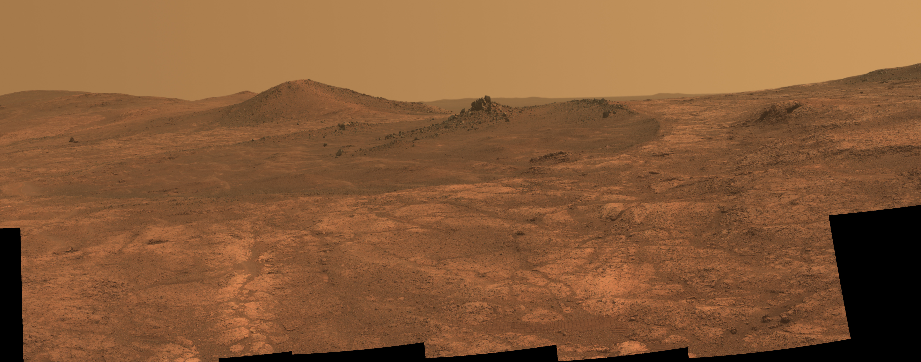
Introduction – About the thesis
Figure 1: Elongated crater ‘‘Spirit of St. Louis’’ on Mars. (Image credit: [1])

Slide 5
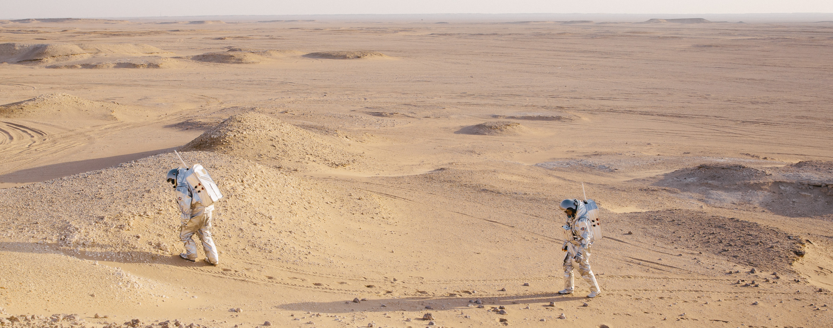
Introduction – About the thesis
Figure 2: Analog astronauts with the OeWF spacesuit simulator Aouda in the Dhofar Desert in
Oman. (Image credit: OeWF/Florian Voggeneder)

Slide 6
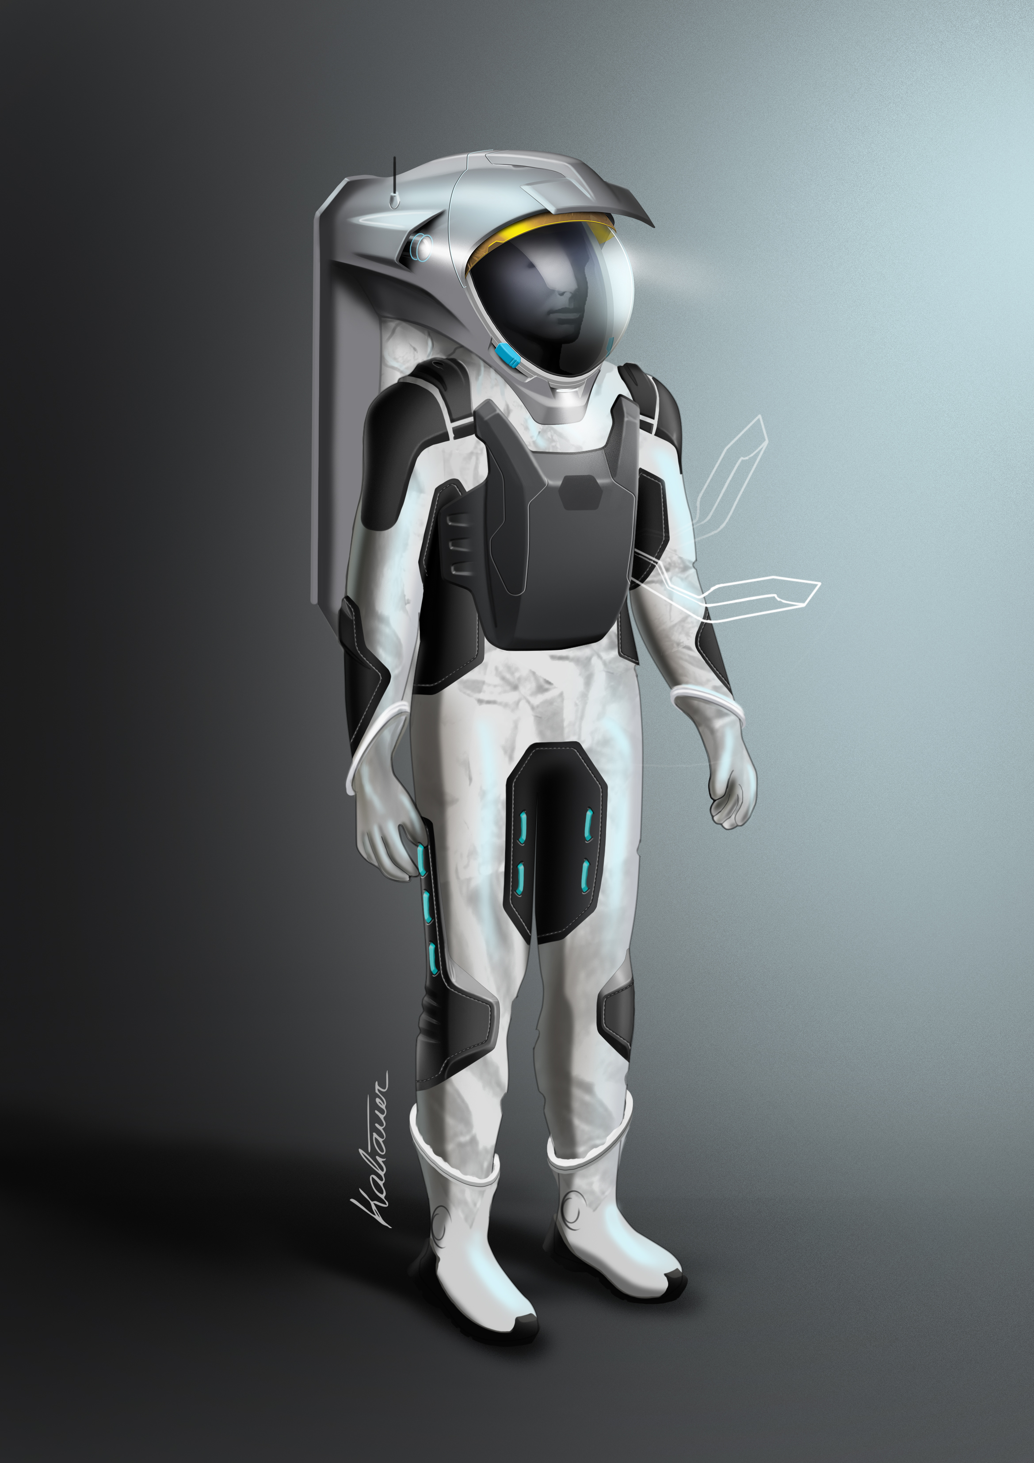
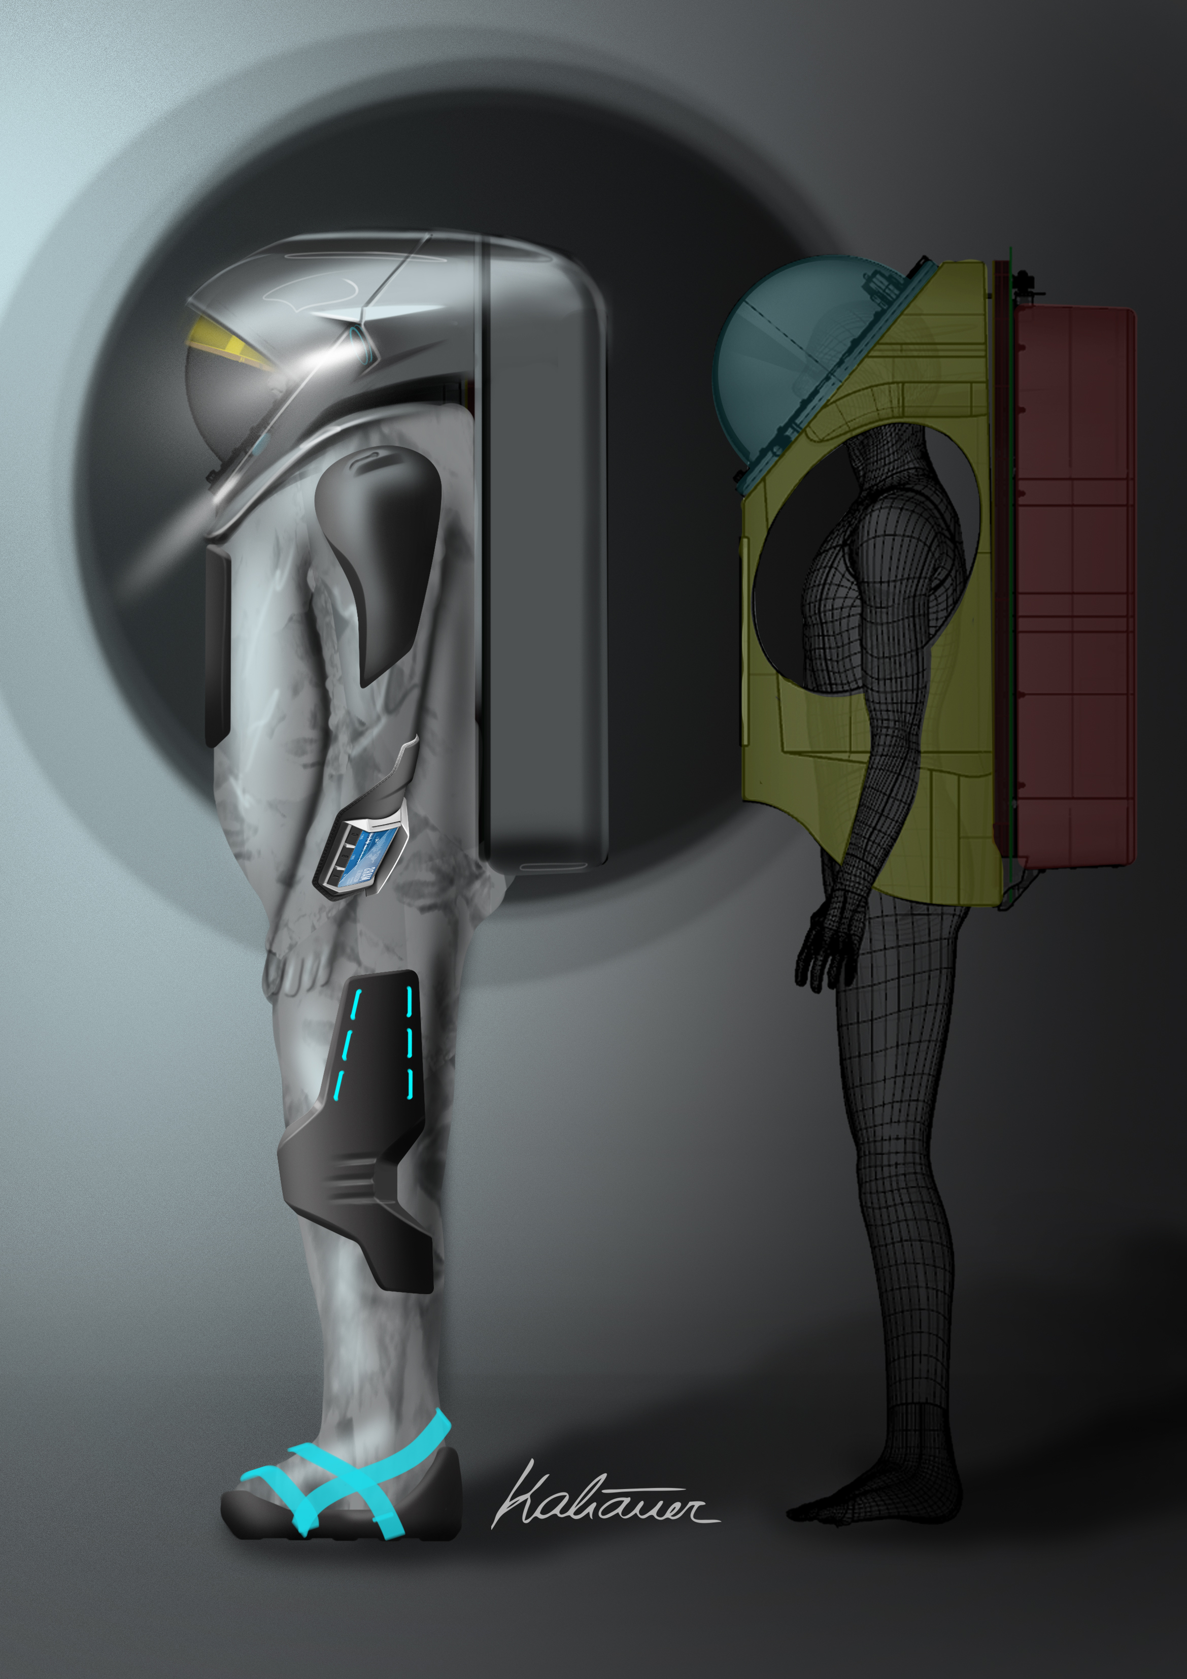
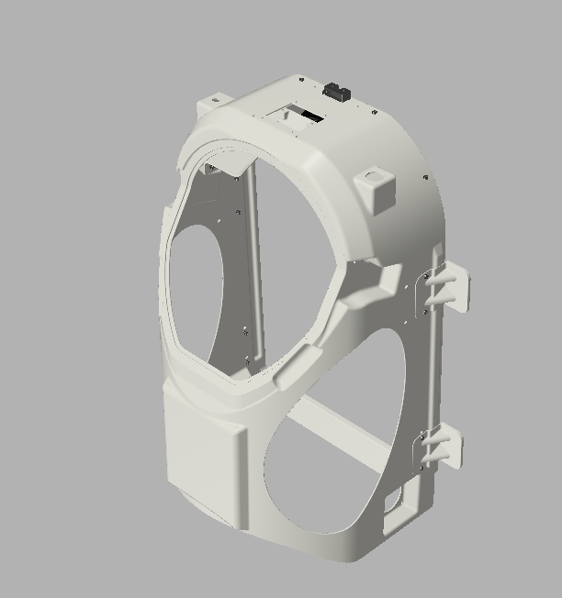
Introduction – About the thesis
Hard upper torso (HUT)
Antenna pass through
Figure 3: (Left and center) Serenity spacesuit simulator design study. (Right) CAD drawing of
the HUT. (Image credit: OeWF/Bernhard Kaliauer Design Studio and OeWF/Matthias Mair)

Slide 7
Introduction – Aim & deliverables
Design a backup voice communication system for the Serenity spacesuit simulator by taking table 1 into account.
If a repeater is necessary, design a self-sufficient energy distribution system for it.
Carry out performance estimation based on the design.
Investigate Martian application.

Slide 8
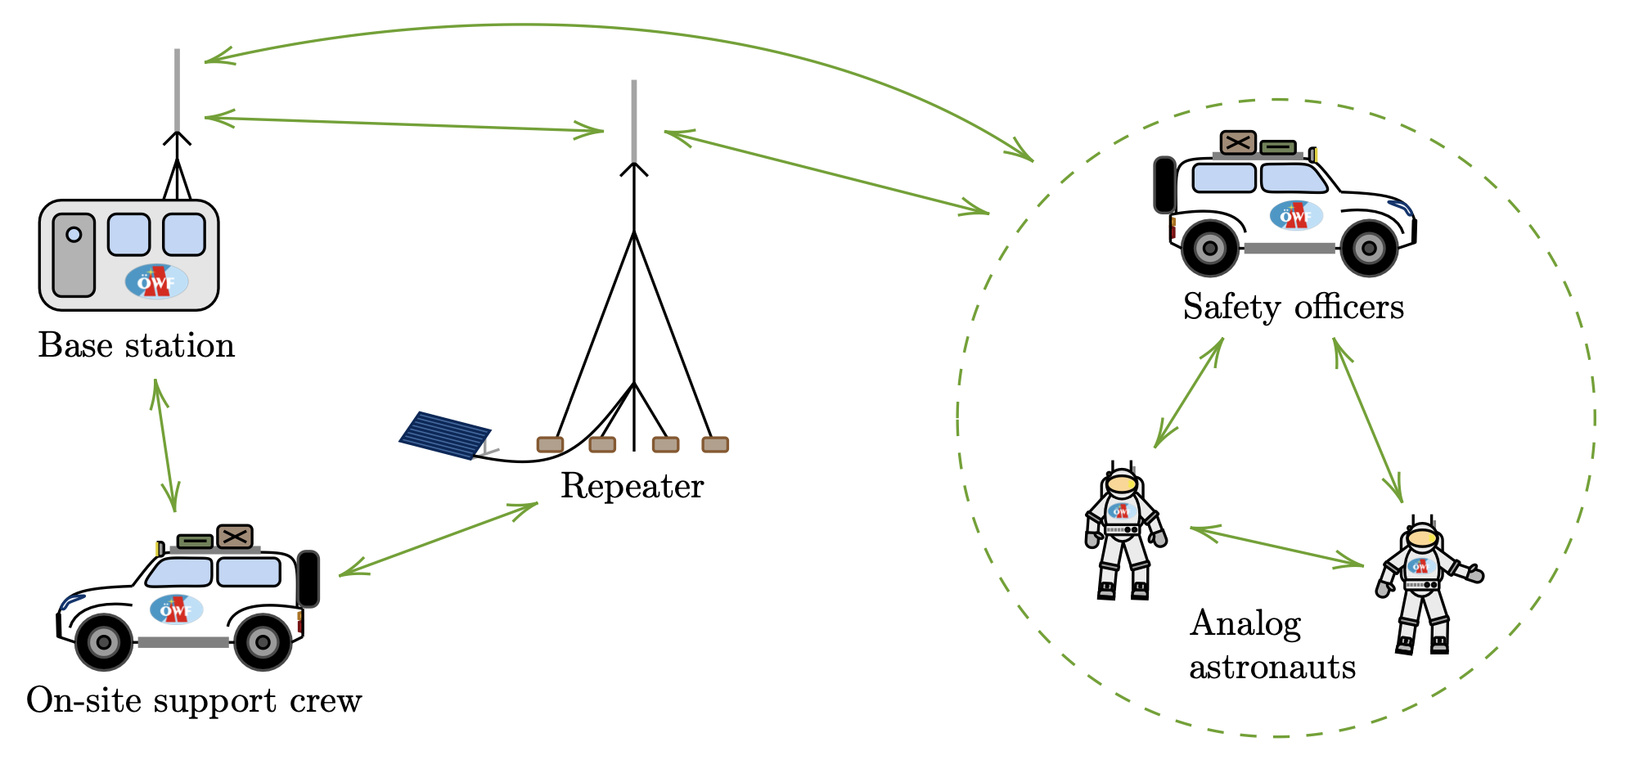
Voice comm. system – System design
Figure 4: System design of the backup voice communication system for the Serenity spacesuit
simulator.

Slide 9

Voice comm. system – System design
Mesh topology with digital voting
System frequency (very high frequency (VHF) band)
Reusing Motorola Mototrbo infrastructure
Vertical polarization of the involved antennas
Self-sufficient energy disribution system for repeater
Taking into account insertion and mismatch losses

Slide 10

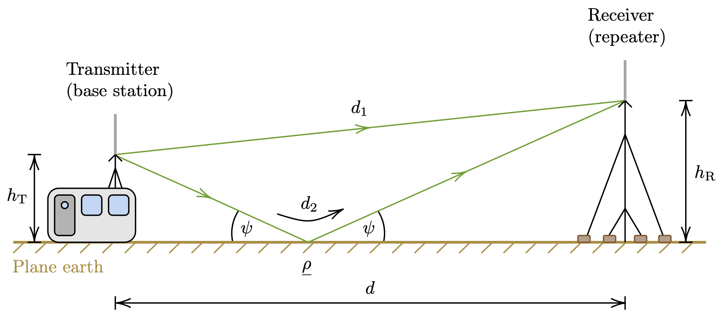

Voice comm. system – Methodology
Free space signal budget → Plane earth signal budget
... complex reflection coeff.
... angle of incidence
Figure 5: Illustration of the plane earth signal budget. (Recreated from [2], [3], [4])

Slide 11
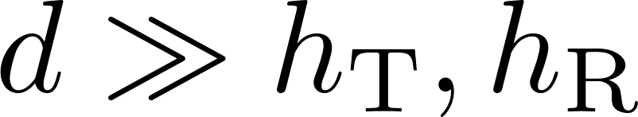
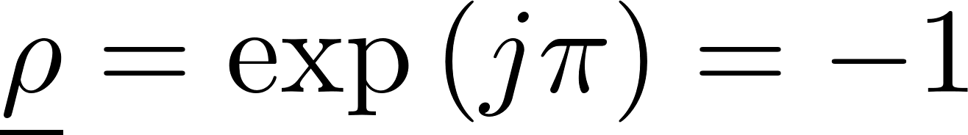
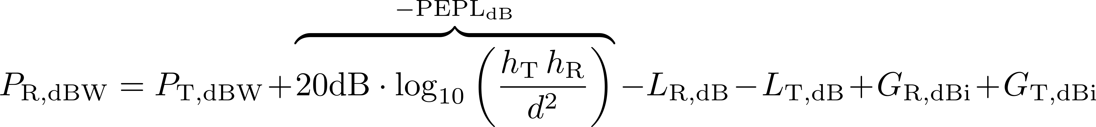
Voice comm. system – Methodology
is small for
Therefore
Perfect reflection of the electromagnetic wave
Because E-field is perpendicular to the plane in the transversal magnetic (TM) mode
Plane earth propagation equation:

Slide 12
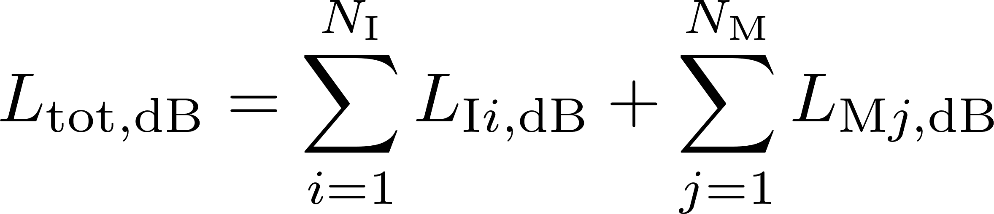
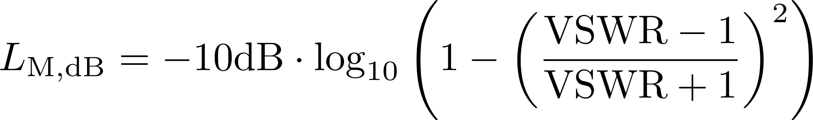

Voice comm. system – Methodology
Total losses are the sum of insertion and missmatch losses:
Missmatch losses:
and VSWR from the datasheets of the involved devices and components

Slide 13
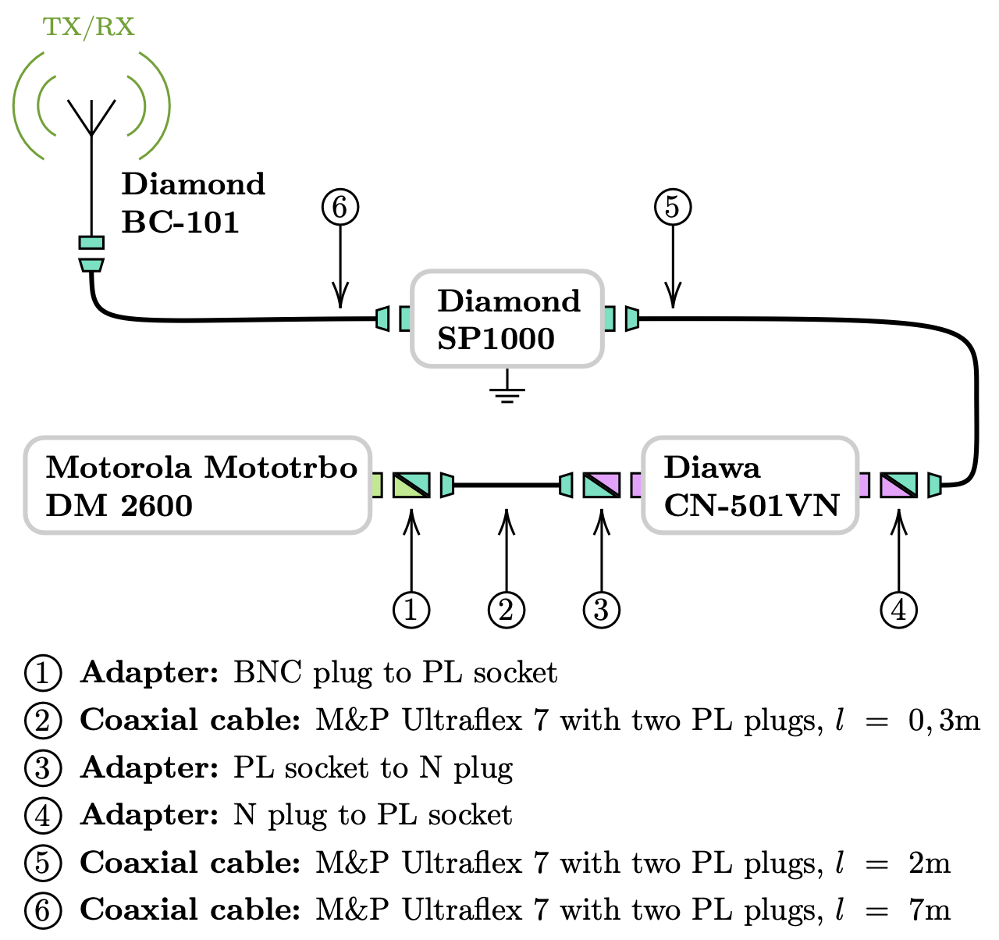





System design – Base station radio infrastructure
 | 17,479dBW
 | -149,031dBW
 | 3,5dBi
 | 1,987dB
(ISO 668) | 2,6 + 1m
Table 2: Specifications for max. transmission
power.
 | 10,49dBW
 | -149,031dBW
 | 3,5dBi
 | 1,987dB
(ISO 668) | 2,6 + 1m
Table 3: Specifications for 5W transmission
power.

Slide 14
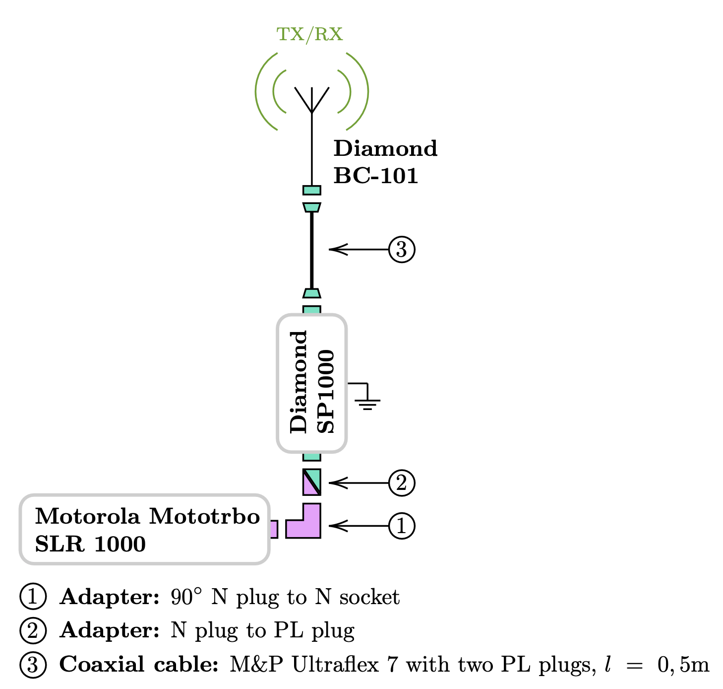
System design – Repeater radio infrastructure
 | 13,5dBW
 | -149,031dBW
 | 3,5dBi
 | 0,849dB
(mast + tripod) | 8m
Table 4: Specifications for max. transmission
power.
 | 10,49dBW
 | -149,031dBW
 | 3,5dBi
 | 0,849dB
(mast + tripod) | 8m
Table 5: Specifications for 5W transmission
power.

Slide 15
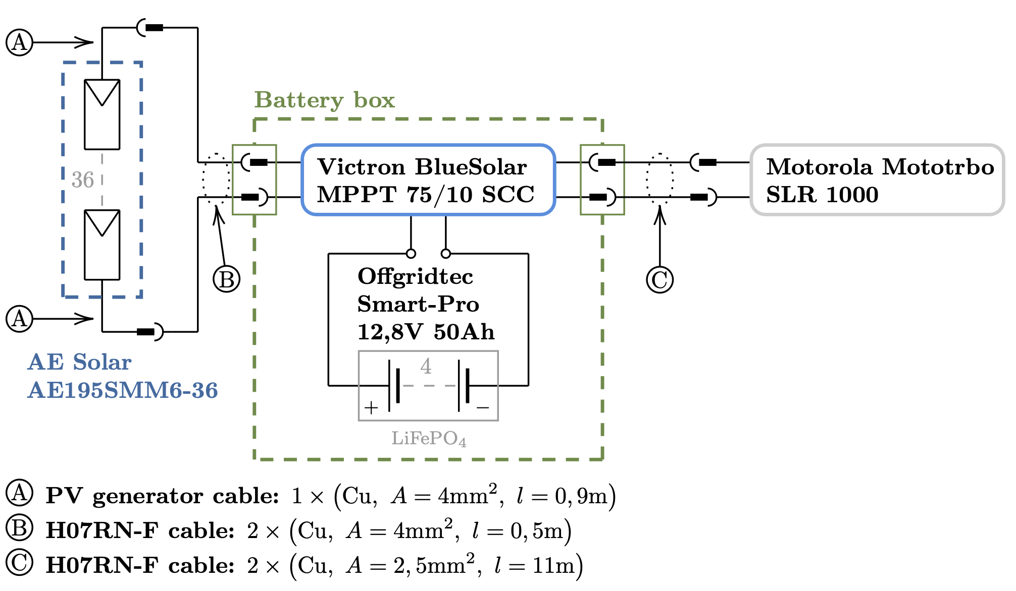
System design – Repeater energy distr. system
Self-sufficient energy
distribution system
Environmentally friendly
Solar energy conversion
In practice more components
involved

Slide 16
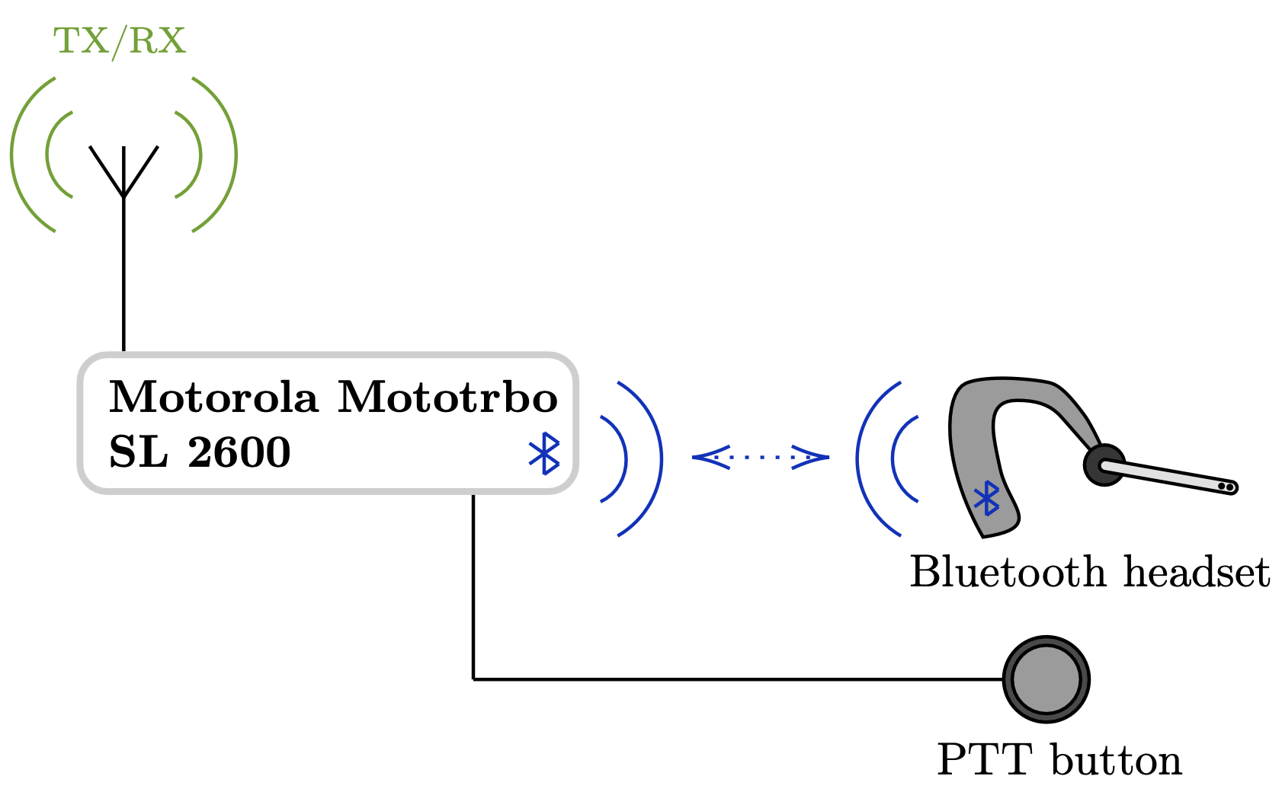
System design – Serenity radio system
 | 4,771dBW
 | -149,031dBW
 | 0dBi (assumed)
 | 0dB (assumed)
(male/female) | 1,65m/1,55m
Table 6: Specifications
Vertical antenna is not detachable
System impedance is assumed to be 50Ω
Assumed antenna gain 0dBi
Assumed antenna feed line losses 0dB

Slide 17
System design – Serenity radio system version 1
Device/Component | Operating temp. Requirements met?
Motorola Mototrbo SL 2600 | ✓
Third party audio jack | ?
Cables & connectors | ✓
PTT button (adopted from Aouda) | ✓
Jabra Storm Bluetooth headset | ?
Table 7: Serenity radio system version 1. Analysis of the operating temperature
within the HUT.
Dimension requirement met? ✓
Combined mass within the HUT: 853,33g
Combined mass requirement met? ?

Slide 18
System design – Serenity radio system version 2
Device/Component | Operating temp. Requirements met?
Motorola Mototrbo SL 2600 | ✓
Motorola Solutions Inc. audio jack | ✓
Cables & connectors | ✓
PTT button (adopted from Aouda) | ✓
Motorola EP900w Bluetooth headset | ✓
Table 8: Serenity radio system version 2. Analysis of the operating temperature
within the HUT.
Dimension requirement met? ✓
Combined mass within the HUT: 866,33g
Combined mass requirement met? ?

Slide 19
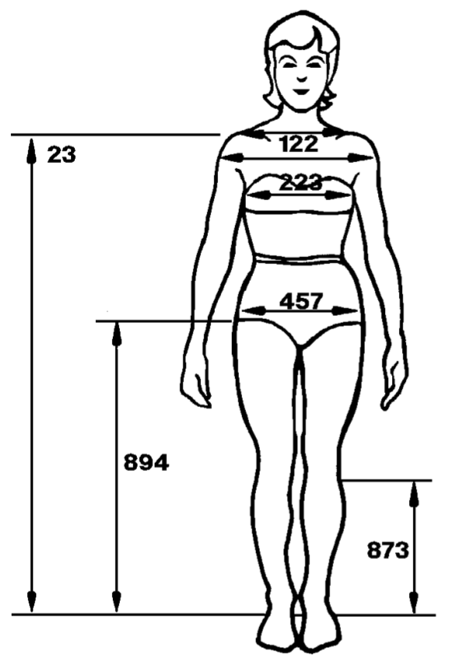
System design – On-site supp. crew & Safety offic.
 | 4,771dBW
 | -149,031dBW
 | 0dBi (assumed)
 | 0dB (assumed)
(jap. female 23) | 1,271m
Table 9: Specifications Safety officers radio
(Motorola Mototrbo SL 2600).
 | 6,99dBW
 | -147,447dBW
 | 0dBi (assumed)
 | 0dB (assumed)
(jap. female 23) | 1,271m
Figure 6: ‘‘Body Size of
the 40-Year-Old Japanese
Female for Year 2000 in
One Gravity Conditions.’’
(Image and caption credit: [5])
Table 10: Specifications On-site support crew
radio (Motorola Mototrbo DP 3601).

Slide 20

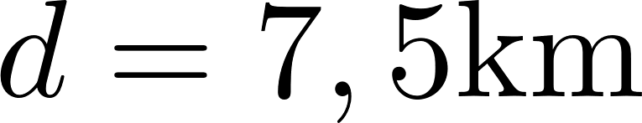


Results – Fade margin max. transmission power
Fade margin = (ideally above 20dB)
Link |  |  | Fade margin
SER → REP | 133,134dB | -125,712dBW | 23,319dB
SER ← REP | 133,134dB | -120,483dBW | 28,548dB
OSS → REP | 134,858dB | -125,217dBW | 23,841dB
OSS ← REP | 134,858dB | -122,207dBW | 25,24dB
BSt → REP | 125,815dB | -107,672dBW | 41,359dB
BSt ← REP | 125,815dB | -111,651dBW | 37,38dB
SFTY → REP | 134,858dB | -127,436dBW | 21,595dB
SFTY ← REP | 134,858dB | -122,207dBW | 26,824dB
Table 11: Results of the fade margin when each radio system of the voice
communication system transmitts with maximum power.

Slide 21
Results – Fade margin 5W transmission power
Fade margin = (ideally above 20dB)
Link |  |  | Fade margin
SER → REP | 133,134dB | -125,712dBW | 23,319dB
SER ← REP | 133,134dB | -123,493dBW | 25,538dB
OSS → REP | 134,858dB | -125,217dBW | 23,841dB
OSS ← REP | 134,858dB | -125,217dBW | 22,23dB
BSt → REP | 125,815dB | -114,661dBW | 34,37dB
BSt ← REP | 125,815dB | -114,661dBW | 34,37dB
SFTY → REP | 134,858dB | -127,436dBW | 21,595dB
SFTY ← REP | 134,858dB | -125,217dBW | 23,841dB
Table 12: Results of the fade margin when each radio system of the voice
communication system is limited to 5W transmission power.

Slide 22
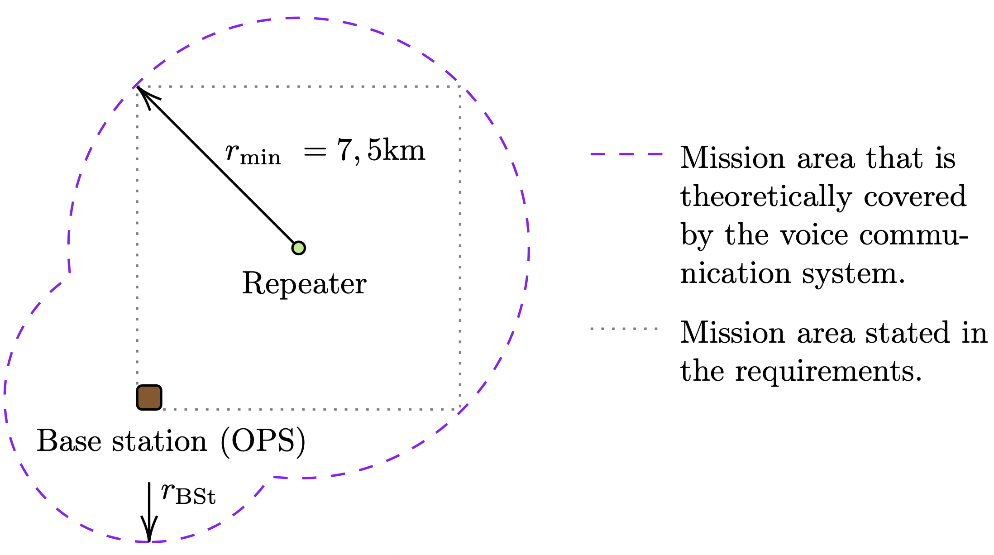

Results – Range
For fade margin 21,595dB
Figure 7: Illustration of the covered mission area.

Slide 23
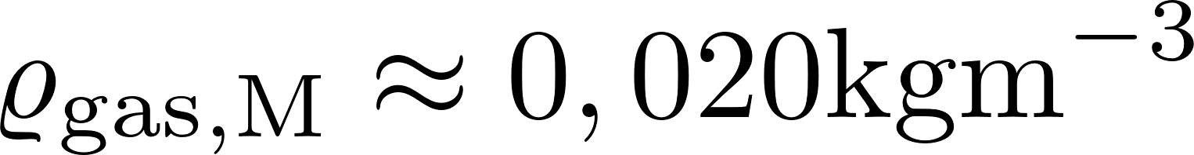
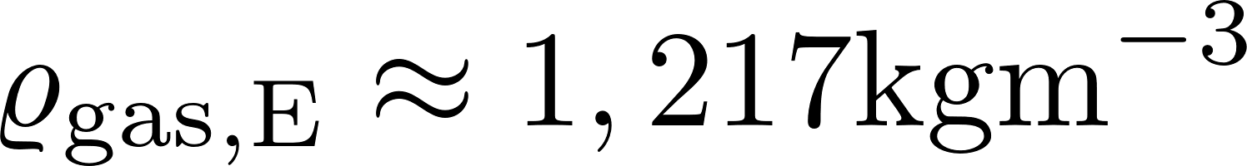
Martian application – Voice comm. system
Noise sources:
Internal noise caused by temperature (worse heat convection due to thinner atmosphere)
Similar wind speeds
Mars atm. dens.:
Earth atm. dens.:
Galactic noise picked up by antennas in the 30MHz to 1GHz range
Man-made-noise caused by other missions on Mars
Link budget:
Topological map
More precise simulations (multipath propagation)
Maximizing range by reducing the amount of necessary infrastructure

Slide 24
Martian application – Voice comm. system
Wave propagation and atmosphere:
Mars has almost no intrinsic magnetic field
Ionosphere as a reflector for VHF waves
Day: Global communication possible
Night: Effect is limited
Troposphere is believed to have little effect on electromagn. waves because it is very thin.
Redundancy:
Reduces risk of system failure
Loss of communication can potentially be dangerous for a crew.

Slide 25
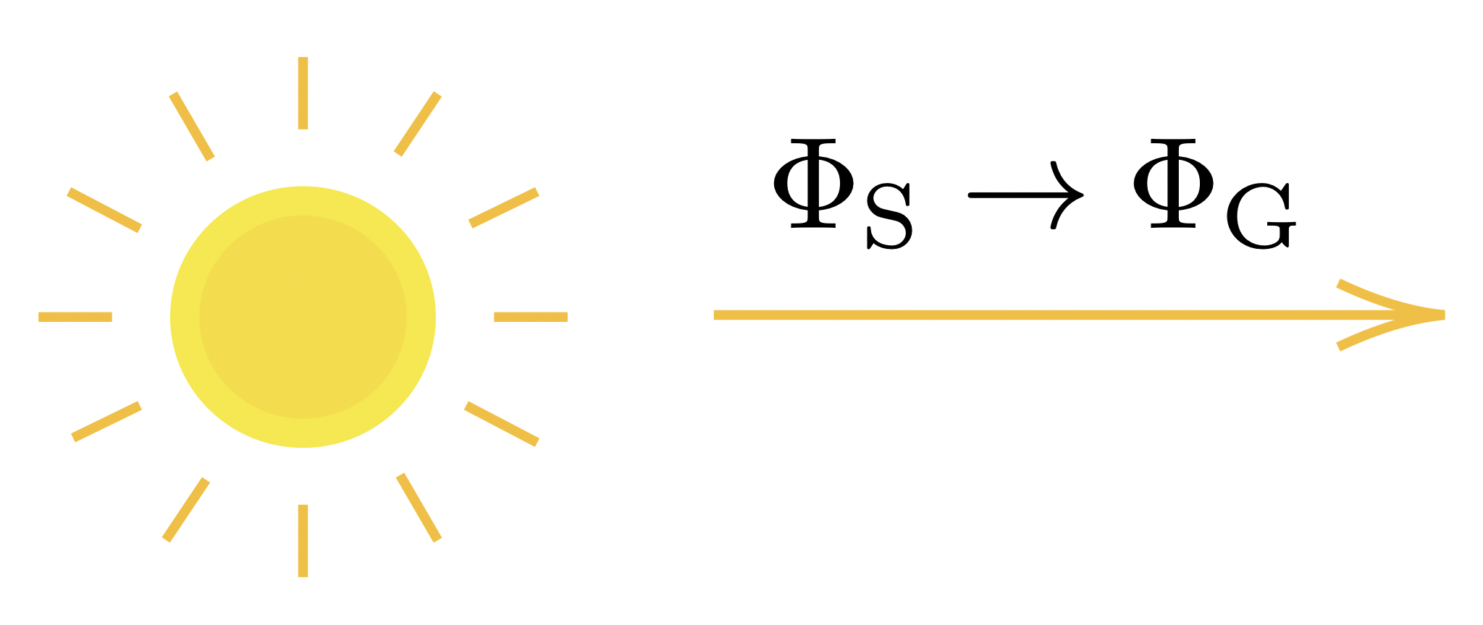
Self-suff. energy distr. system – Methodology

Slide 26
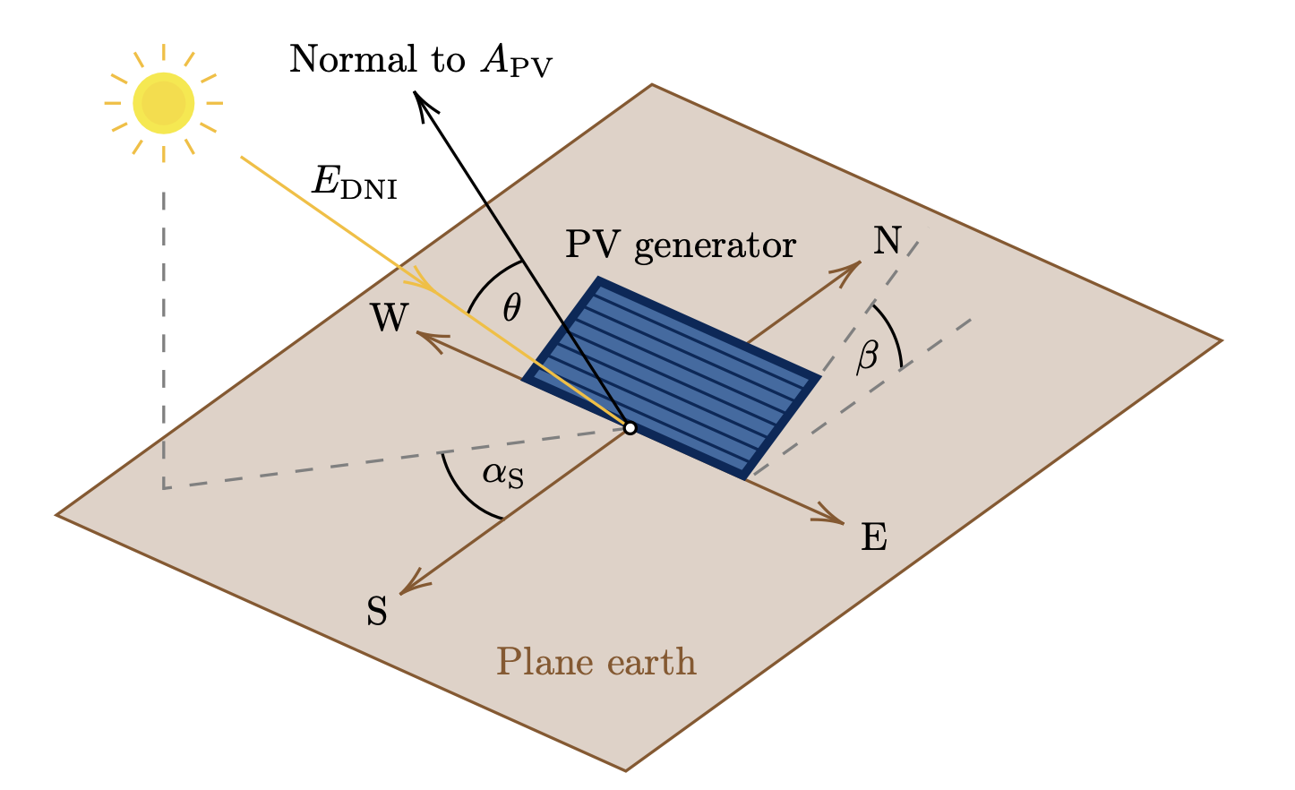





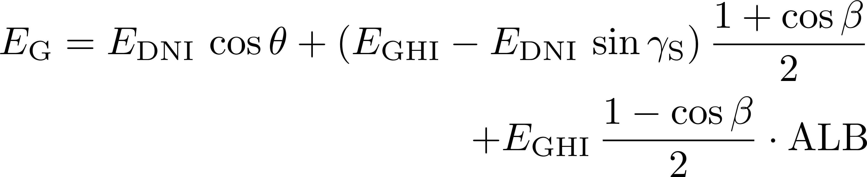
Methodology – Three component model
... direct normal irradiance
... global horizontal irradiance
... angle of incidence
... Albedo
... Altitude of the Sun
Three component model:
Figure 8: Illustration of the direct normal
irradiance onto a tilted PV generator.
(Recreated from: [6])

Slide 27
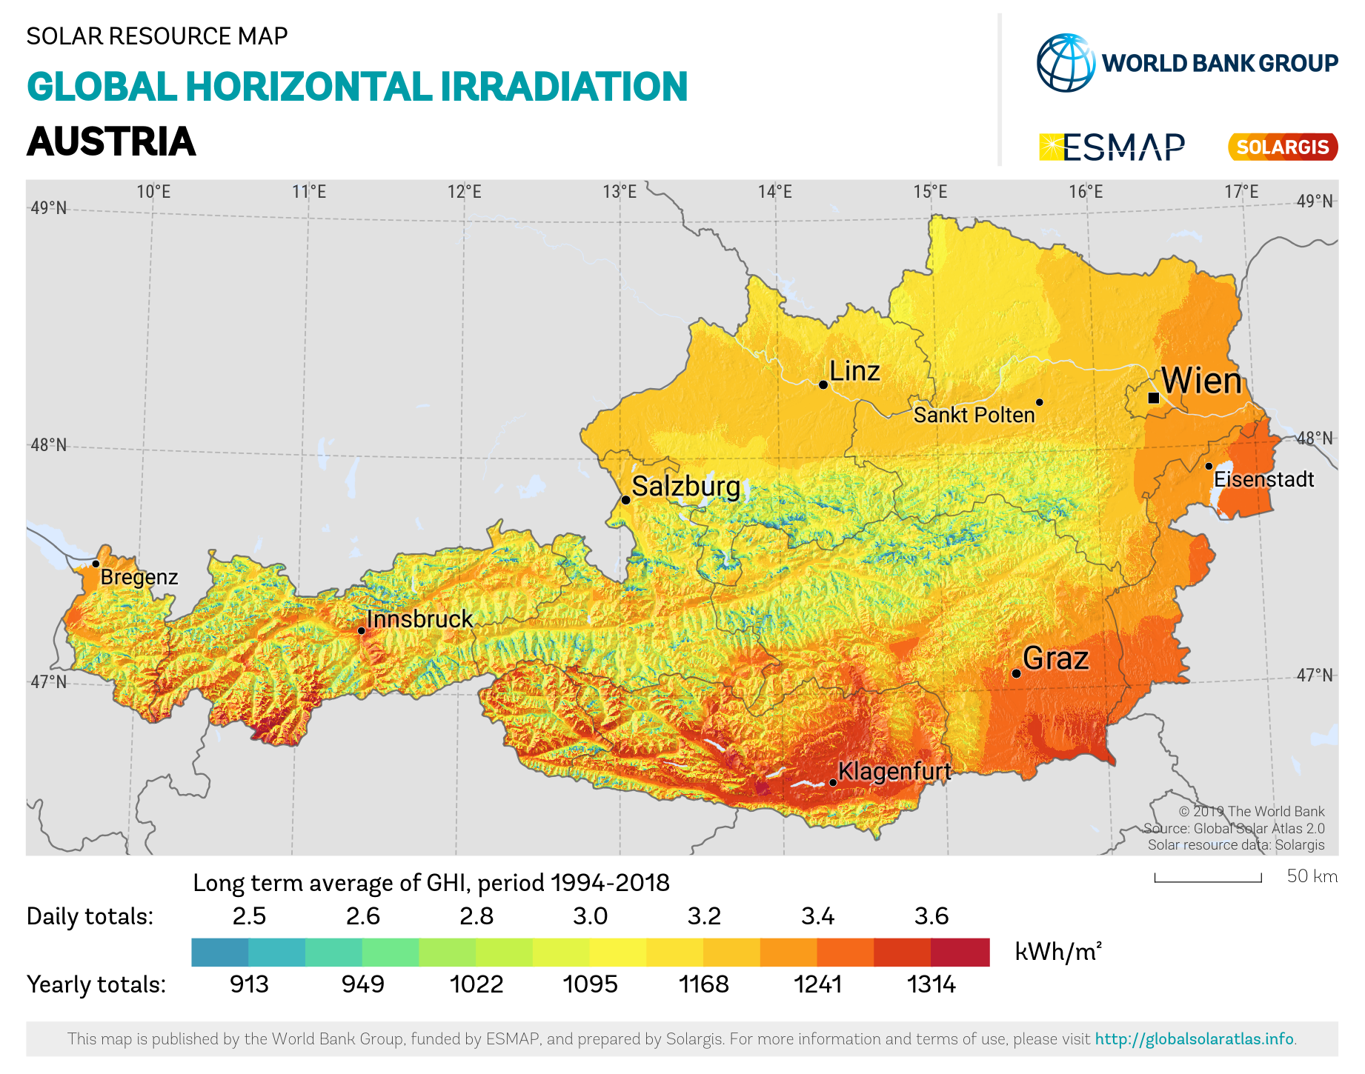
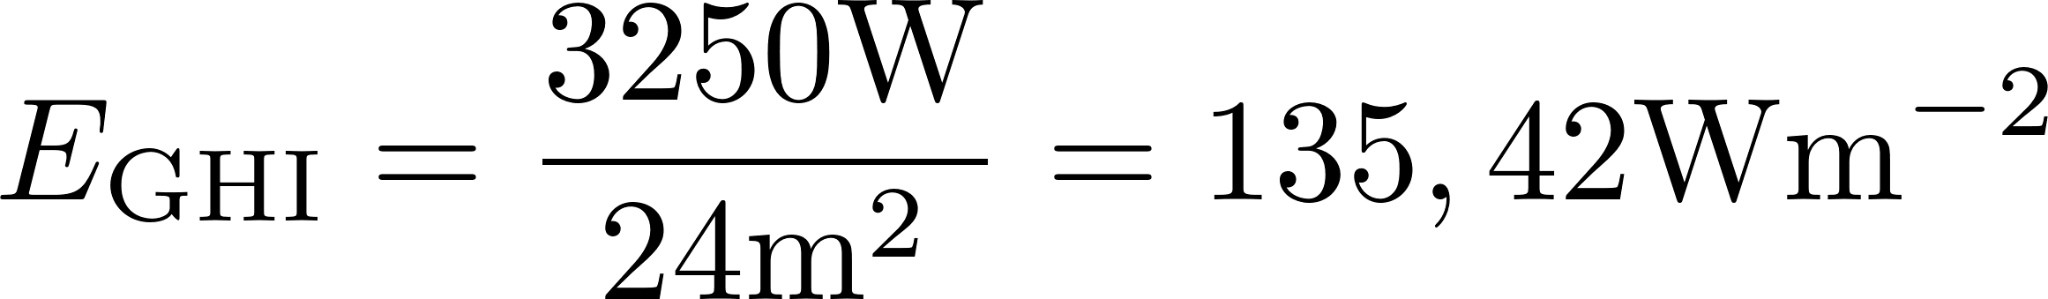
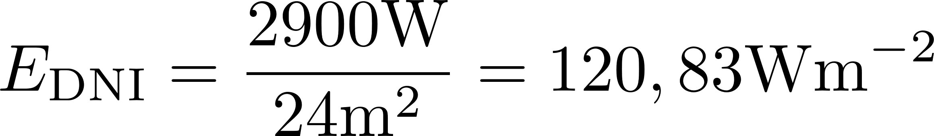
Methodology – Solar resource maps
Figure 9: Solar resource map
of the longterm average global
horizontal irradiation of Austria.
(Image credit: [7])
Example: in Vienna
Example 2: in Vienna

Slide 28

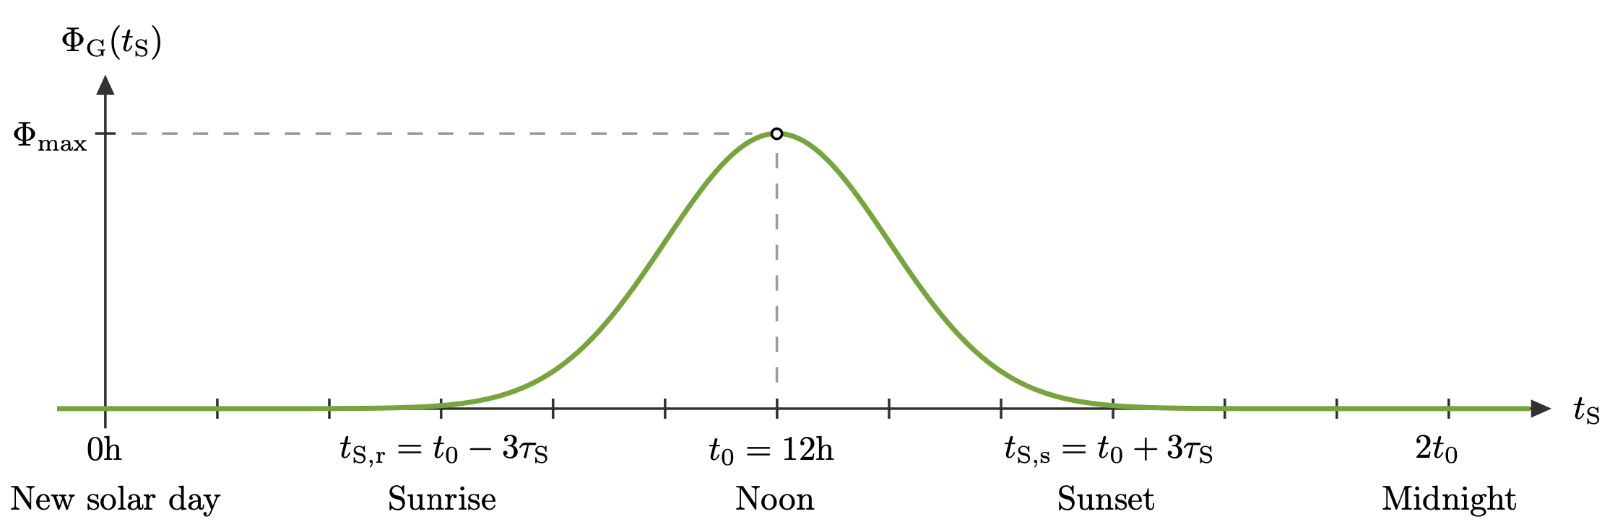
Methodology – Solar energy curve
Radiation flux onto the PV generator:
Gaussian fitting curve:
Figure 10: Model of the Sun’s radiation flux onto the PV generator over the course of one day.

Slide 29
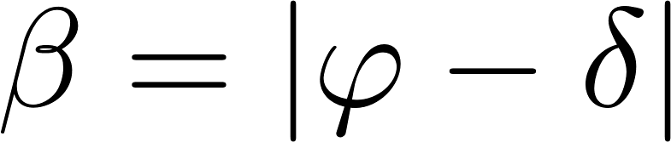
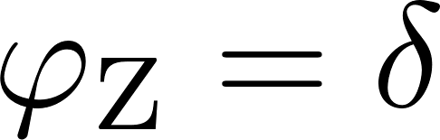



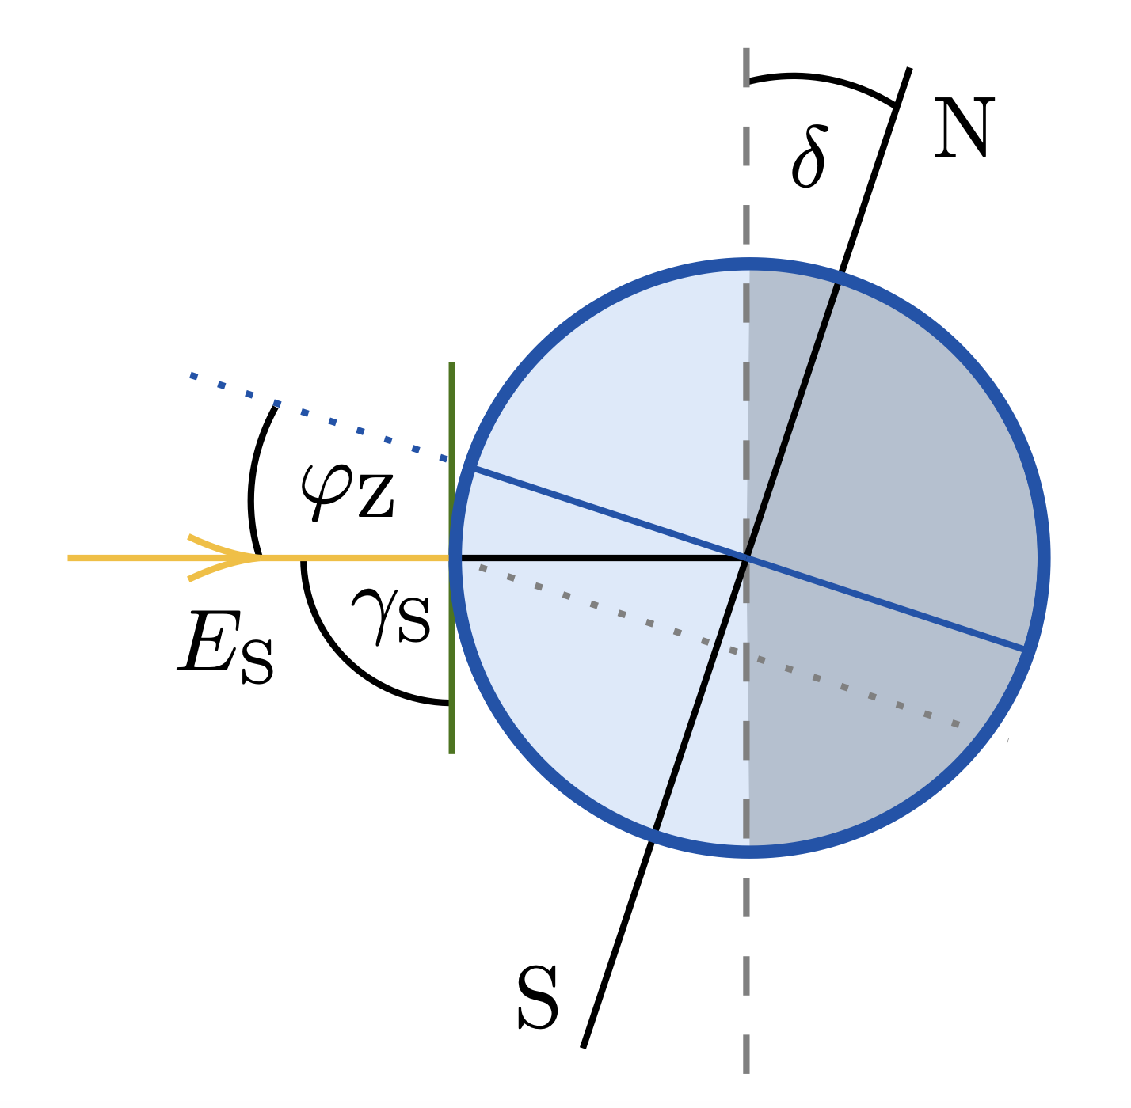
Methodology – PV generator installation
Angle on inclination:
Latitude at which the Sun is at its zenith:
north of → align with south
south of → align with north
→ flat on plane earth
Figure 11: Illustration of the
latitude at which the Sun
is at its zenith for solar noon.
The blue circle represents the
cross section of Earth.

Slide 30
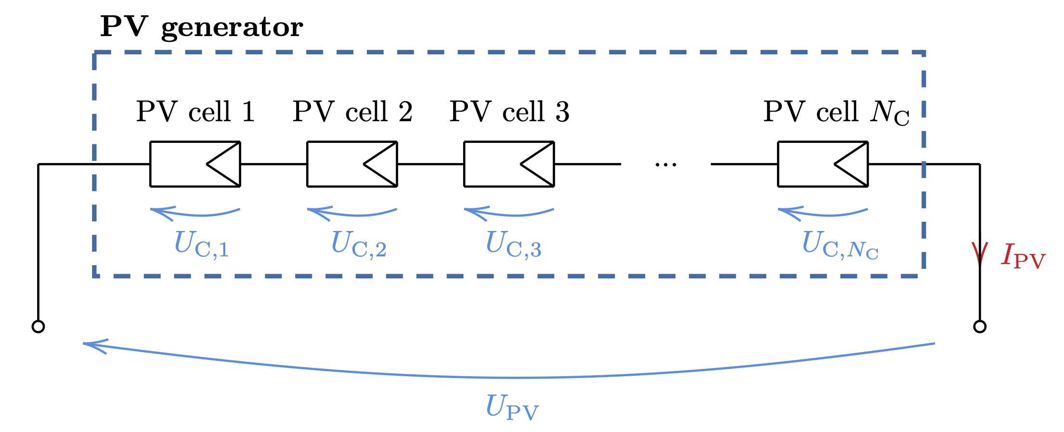





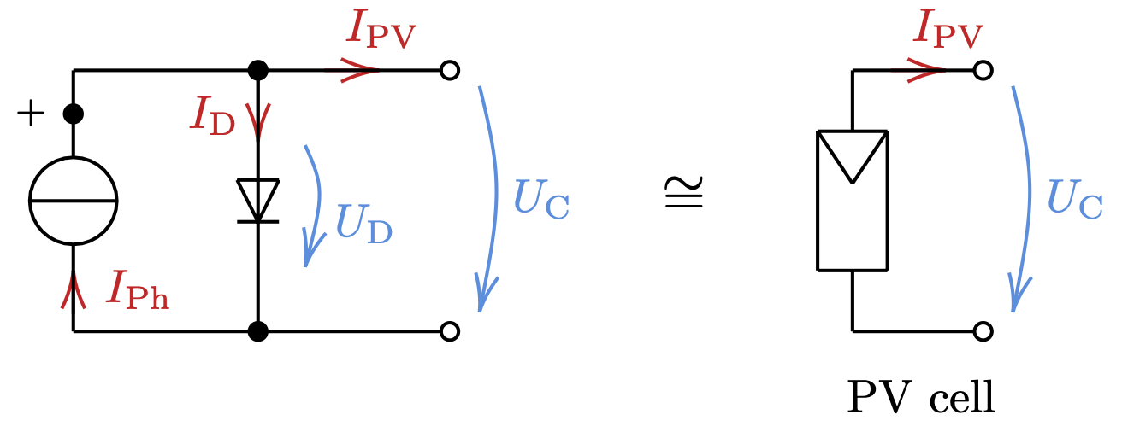
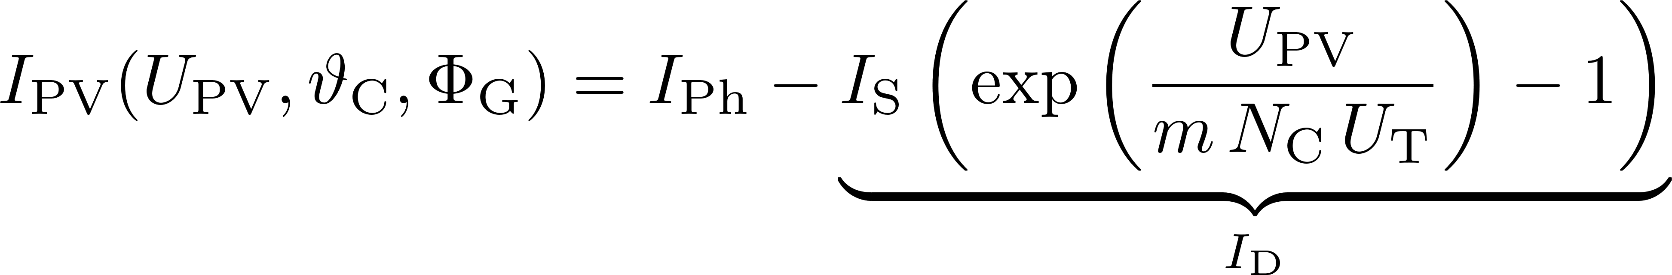
Methodology – PV generator model
... PV cell temperature
... Photocurrent
... Reverse saturation current
... Ideality factor
... Thermal voltage
PV generator current:
Figure 12: Electrical equivalent circuit
of a PV generator and its PV cells.
(Recreated from: [8], [9])

Slide 31
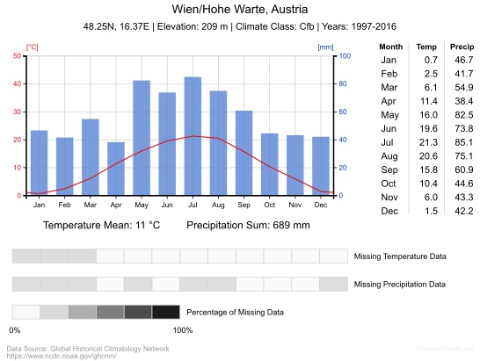


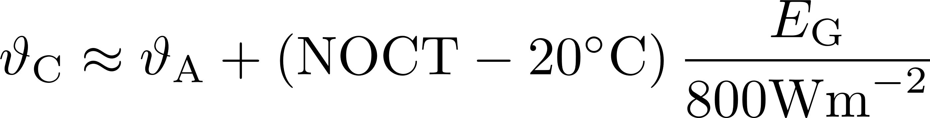
Methodology – PV generator model
PV cell temperature depends on the
ambient temperature and :
can be obtained from recorded
data by weather stations.
Figure 13: Monthly averages of temp.
and precipitation data for the Hohe
Warte in Vienna, Austria.
(Image credit: [10])

Slide 32
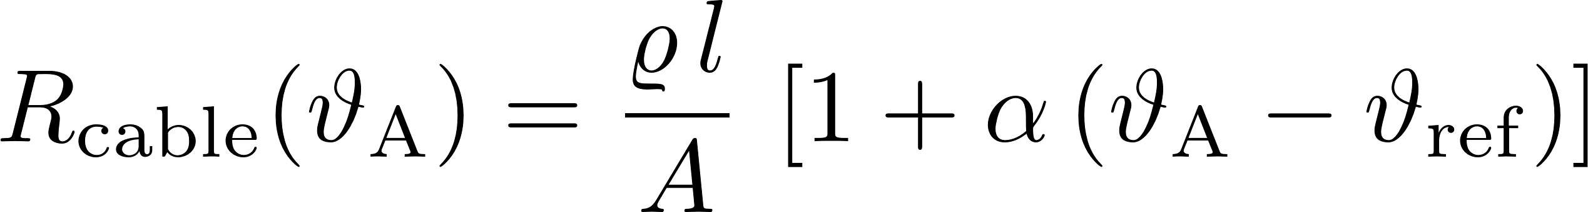
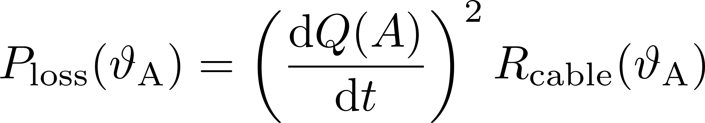
Methodology – Cable losses and SCC
Cable losses:
Temperature dependence is taken into account:
MPP tracking solar charging controller:
Electronic component
Controll algorithm finds MPP:
Information can be obtained
from its user manual and [8].

Slide 33
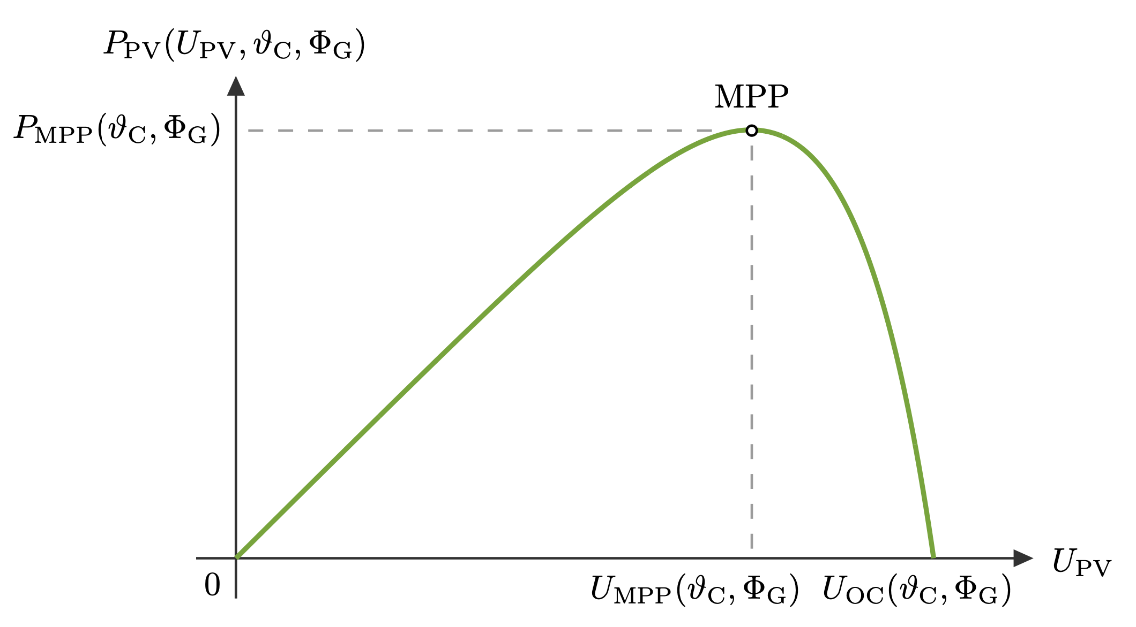
Methodology – Cable losses and SCC
Subsequently the voltage
and current at MPP can
be calculated.
Figure 14: Electrical power output of the PV generator as a
function of the PV generator voltage. (Recreated from: [8])

Slide 34

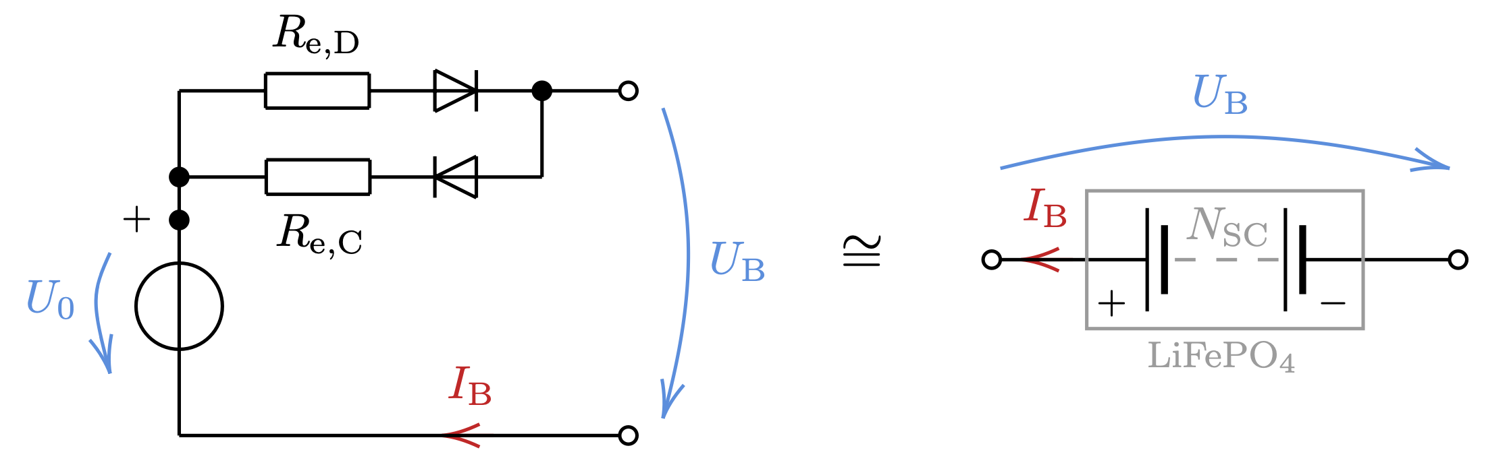






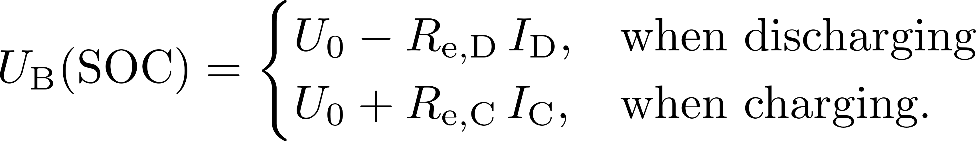
Methodology – battery model
... State of charge of the battery
... Open-circuit voltage
... Electrolyte resistance when discharging
... Electrolyte resistance when charging
Figure 15: model of a lithium iron phosphate
battery. (Recreated from: [11],[12])
Ideal diodes represent current flow
, and depends on the SOC
Obtaining parameters from experiments
Battery voltage:

Slide 35

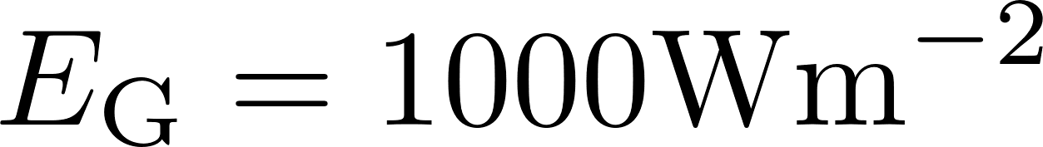
Results – PV generator model
Modeled power-voltage characteristic of the AE Solar AE195SMM6-36 PV generator:
Figure 16: Power-voltage characteristic depends
on with .
Figure 17: Power-voltage characteristic depends
on with .

Slide 36
Results – PV generator model
Modeled power-voltage characteristic of the DAS Energy DAS145PF PV generator:
Figure 18: Power-voltage characteristic depends
on with .
Figure 19: Power-voltage characteristic depends
on with .

Slide 37
Results – battery model
Experimental data of the Offgridtec Smart-Pro 12,8V 50Ah battery:
Figure 20: Recorded open-circuit voltages during
charging and discharging and theit mean value
as a function of the SOC.
Figure 21: Recorded electrolyte resistances during
charging and discharging as a function of the SOC.

Slide 38

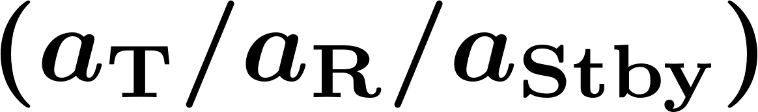
Results – MATLAB simulation AMADEE-20
Coordinates of mission location | 30,500°N 34,917°E
Total mission duration | October 4th to 31st 2021
Daily mission duration (UTC) | 4:00h to 14:00h
Average ambient temperature | 22,3°C
Global horizontal irradiation | 6,05kWhm
Direct normal irradiation | 6,85kWhm
Albedo (Sand) | 0,30
Repeater duty cycle | 20%/20%/60%
PV generator | AE Solar AE195SMM6-36
Number of PV generators | 1
Initial SOC of the battery | 0,6
Table 13: Simulation input for the OeWF’s next analog Mars field mission
AMADEE-20 in the Negev Desert in Israel.

Slide 39
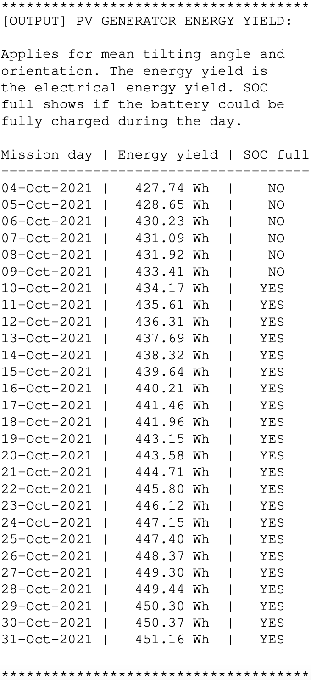
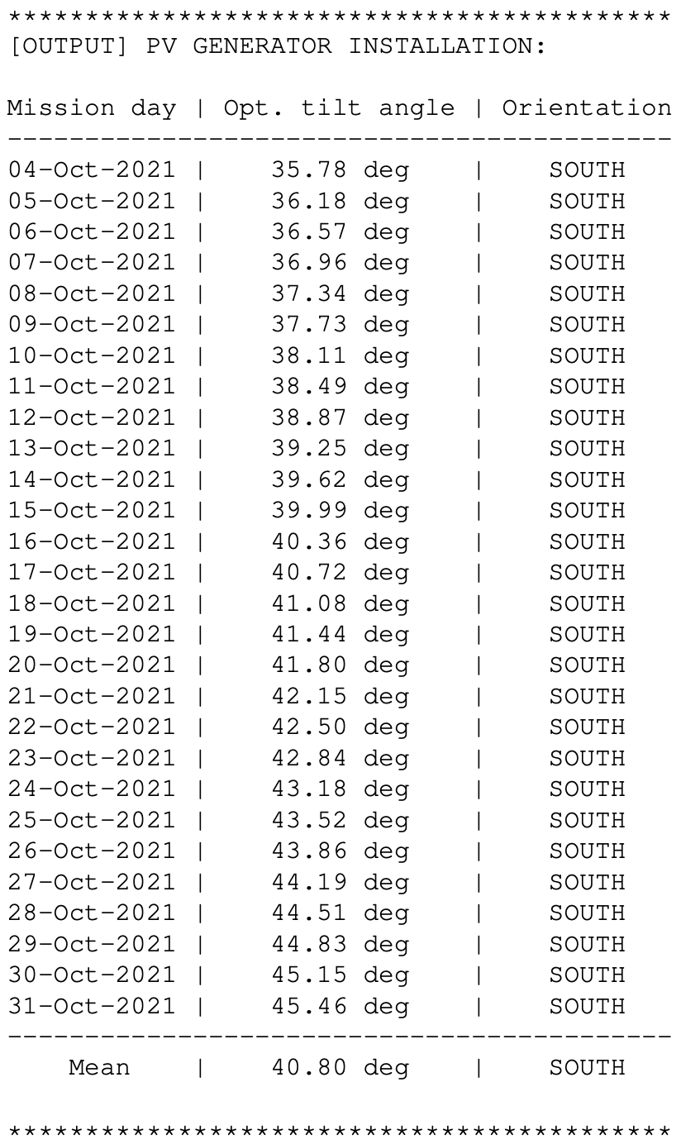
Results – MATLAB simulation AMADEE-20
Optimal inclination angle for each day
Optimal alignment for each day
Calculates daily energy yield
Shows if the battery gets fully charged
Figure 22: Simulation output for the OeWF’s
next analog Mars field mission AMADEE-20
in the Negev Desert in Israel.

Slide 40
Results – MATLAB simulation Vienna
Coordinates of mission location | 48,210°N 16,363°E
Total mission duration | April 1st to 30th 2021
Daily mission duration (UTC) | 5:00h to 15:00h
Average ambient temperature | 11,4°C
Global horizontal irradiation | 3,25kWhm
Direct normal irradiation | 2,90kWhm
Albedo (Sand) | 0,25
Repeater duty cycle | 20%/20%/60%
PV generator | AE Solar AE195SMM6-36
Number of PV generators | 2 (parallel)
Initial SOC of the battery | 0,6
Table 14: Simulation input for Vienna in Austria.

Slide 41
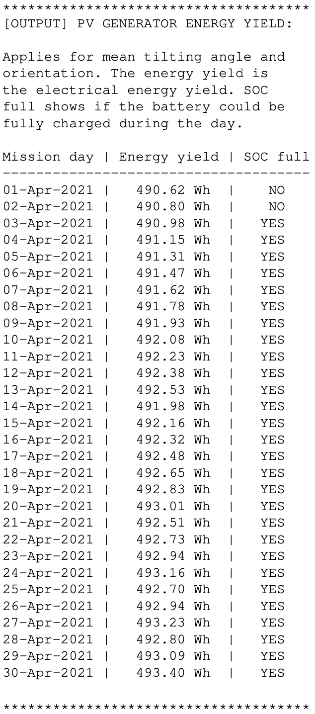
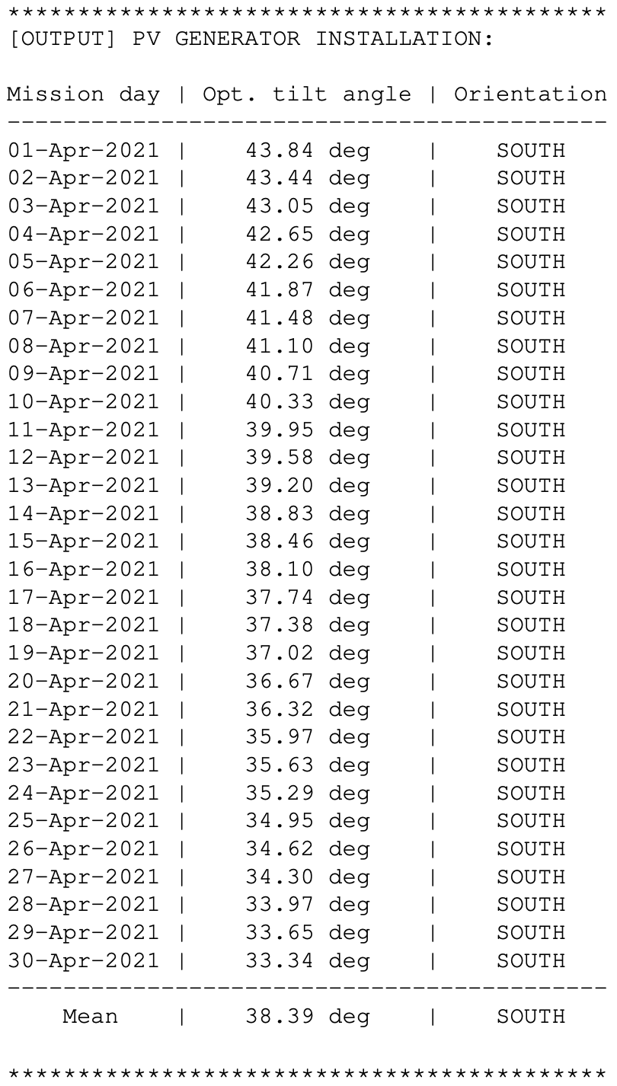
Results – MATLAB simulation Vienna
Optimal inclination angle for each day
Optimal alignment for each day
Calculates daily energy yield
Shows if the battery gets fully charged
Figure 23: Simulation output for Vienna in
Austria.

Slide 42
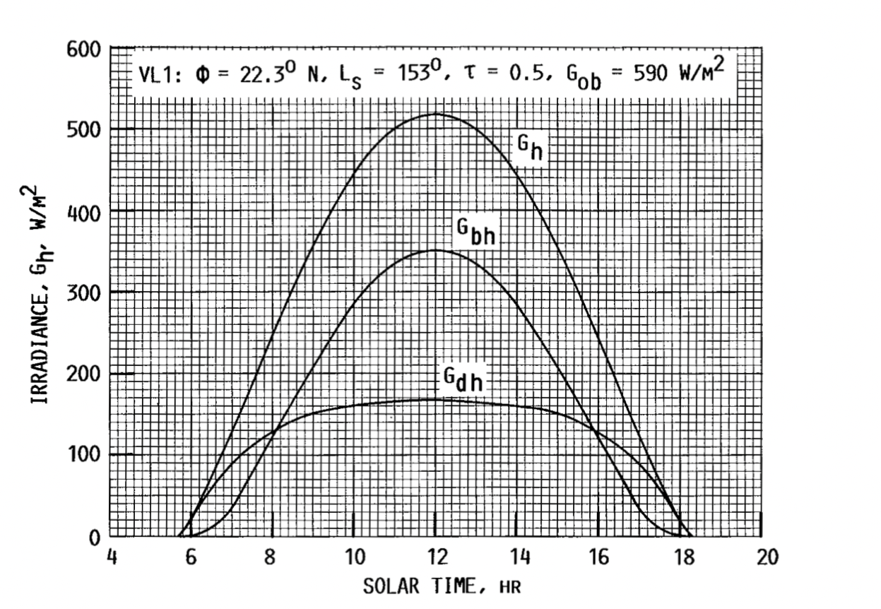
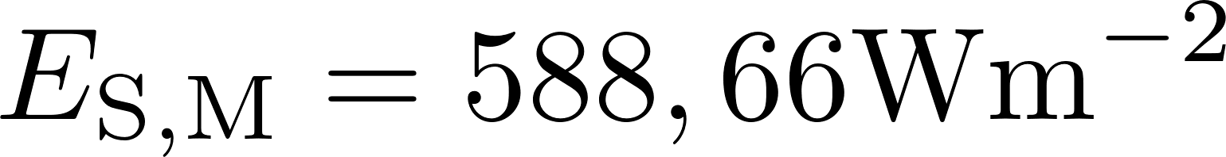
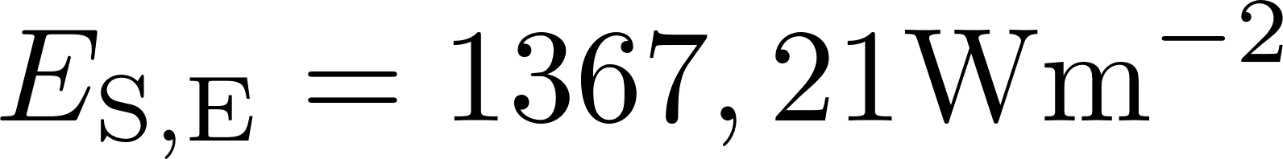




Martian application – Self-suff. En. distr. syst.
Solar irradiance:
At the top of the atmosphere
Mars:
Earth:
56,9% less solar irradiance
Due to greater distance to the Sun
Diurnal variation of the GHI, DHI and
DIFH at NASA’s Viking Lander VL1.
ALB varies between 0,1 and 0,4
(mean = 0,25)
... Global horizontal irradance (GHI)
... Direct normal irradiance (DNI)
Figure 24: Diurnal variation of global, beam
and diffuse irradiance on a horizontal Mars
surface at Viking Lander VL1.
(Image credit: [13])
... Diffuse horizontal irradiance (DIFH)
... Solar irradiance in orbit

Slide 43


Martian application – Self-suff. En. distr. system
Solar irradiance:
Temperature:
Larger PV generator area required:
Only a rough approximation
If planned accordingly, PV generators
can generate enough electrical energy
during dust stroms.
Dust accumulation becomes a problem.
The effect of the ambient temperature
needs to be investigated.
Power output of PV generator strongly
depends on the PV cell temperature.
batteries usually have an
operating temperature from 5°C to 45°C.
In both cases a temperature control might
be necessary.
Good planning and dimensioning of the system
is necessary.

Slide 44
Conclusion – Voice communcation system
Deliverables:
Design a backup voice communication system for the Serenity spacesuit simulator by taking table 1 into account. ✓
Investigate Martian application. ✓
Findings:
Plane earth propagation equation can be used to design such a system.
Repeater infrastructure is necessary for sufficiently large fade margin.
The Martian ionosphere can be used as a reflector for global communication during the day.
Temperature dependence of the devices and components must not be neglected.

Slide 45
Conclusion – Self-suff. energy distribution system
Deliverables:
If a repeater is necessary, design a self-sufficient energy distribution system for it. ✓
Carry out performance estimation based on the design. ✓
Investigate Martian application. ✓
Findings:
MATLAB simulation provides information of wether a the repeater infrastructure can be operated
at a certain mission location on Earth.
Temperature dependence of the devices and components must not be neglected.

Slide 46
Critical reflection – Voice communcation system
Investigation of noise sources necessary.
Taking into account the influence of the Earth atmosphere.
Multipath propagation simulation can be carried out for more precise planning.
Experiments with the assembled system need to be carried out to gather empirical data.
Further investigation of Martian application.

Slide 47

Critical reflection – Self-suff. energy distr. system
Use Capderou method [14] instead of Gaussian fitting curve for .
Two diodes model for PV cells.
Taking into account the temperature dependence, the transient behavior and capacity fading of
batteries.
Improving the MATLAB simulation.
Further investigation of Martian application.

Slide 48
Summary
Introduction
About the thesis
Aim & deliverables
Voice communication system for a spacesuit simulator
System design & Methodolgy
Results & martian application
Self-sufficient energy distribution system
System design & Methodolgy
Results & martian application
Conslusion & critical reflection
Voice communication system
Self-sufficient energy distribution system

Slide 49
References
[1] National Aeronautics and Space Administration, Rock spire in ’spirit of st. louis crater’ on mars, Aug. 2017. [Online].
Available: https://www.nasa.gov/jpl/mer/pia19393/rock-spire-in-spirit-of-st-louis-crater-on-mars (visited on
04/13/2021).
[2] I. A. Glover and P. M. Grant, Digital Communications, 3rd ed. Essex, England: Prentice Education Limited, 2010.
[3] J. D. Parsons, The mobile Radio Propagation Channel, 2nd ed. Sussex, Eng- land: John wiley & Sons, Ltd, 2000.
[4] A. M. J. Goiser, Telekommunikation, V 1.1b. Vienna, Austria: Institute of Telecommunications, 2019.
[5] National Aeronautics and Space Administration, 3 anthropometry and biomechanics, Aug. 2020. [Online]. Available:
https://msis.jsc.nasa.gov/sections/section03.htm (visited on 04/13/2021).
[6] J. Appelbaum, I. Sherman, and G. Landis, “Solar radiation on mars: Stationary photovoltaic array,” NASA Technical
Memorandum, no. 106321, pp. 1–19, 1993.
[7] Solargis, Weather data and software for solar power investments, 2021. [Online]. Available: https://solargis.com/
(visited on 04/13/2021).
[8] K. Mertens, Photovoltaik, 3rd ed. Munich: Carl Hanser Verlag, 2015.
[9] A. Wagner, Photovoltaik Engineering, 5th ed. Berlin: Springer-Verlag GmbH Deutschland, 2018.
[10] L. Zepner, P. Karrash, F. Wiemann, et al., An interactive climate analysis web platform, 2020. [Online]. Available:
https://climatecharts.net/ (visited on 04/13/2021).
[11] H. Hinz, “Comparison of lithium-ion battery models for simulating storage systems in distributed power generation,”
Inventions, vol. 4, pp. 1–22, 2019.
[12] G. Saldaña, J. I. S. Martín, I. Zamora, et al., “Analysis of the current electric battery models for electric vehicle
simulation,” Energies, vol. 12, pp. 1–27, 2019.
[13] J. Appelbaum and D. J. Flood, “Solar radiation on mars,” NASA Technical Memorandum, no. 102299, pp. 1–31, 1989.
[14] M. H. Babikir, D. Njomo, M. Barka, et al., “Modeling the incident solar radiation of the city of n’djamena (chad) by
the capderou method,” International Journal of Photoenergy, vol. 2020, pp. 1–10, 2020.

